Slide 1
Cross-Domain Image Translation Based on GAN
Wu, 2017/12/19

Slide 2
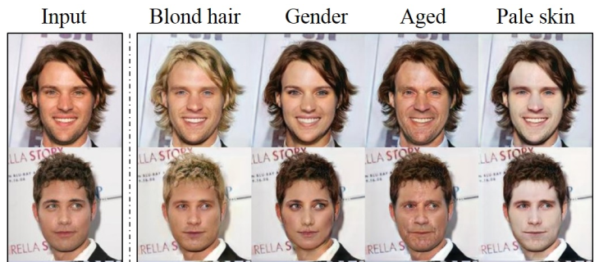

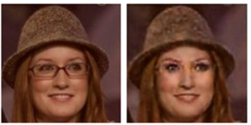
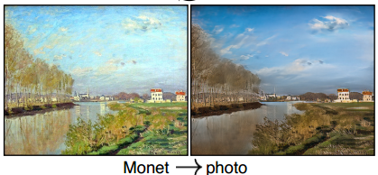
Cross-Domain Image Translation
Domain: a set of images sharing the same attribute value
Examples
Change facial expression
Age Progression
Change seasons
Change or remove some objects
Image Super-Resolution

Slide 3
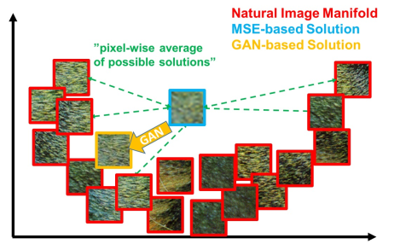
Reason for using GAN
Difficulties of traditional methods
How to design effective loss
How to use unpaired data
GAN’s advantages
No need of the specific loss, but a high level goal
Able to handle unpaired data
GAN’s disadvantages
The Generator network often produce insensitive results
Mode collapse: all inputs are mapped to the same output

Slide 4
Overview of today’s topic
Supervised, Paired Data
Pix2pix: Image-to-Image Translation with cGAN
SRGAN: Photo-Realistic Single Image Super-Resolution Using a GAN
Unsupervised, Unpaired Data
DIAT: Deep Identity-aware Transfer of Facial Attributes
DTN: Unsupervised Cross-Domain Image Generation
CycleGAN: Unpaired Image-to-Image Translation using Cycle-Consistent Adversarial Networks
StarGAN: Unified GAN for Multi-Domain Image-to-Image Translation

Slide 5
Pix2pix: Image-to-Image Translation with cGAN
CVPR 2017

Slide 6
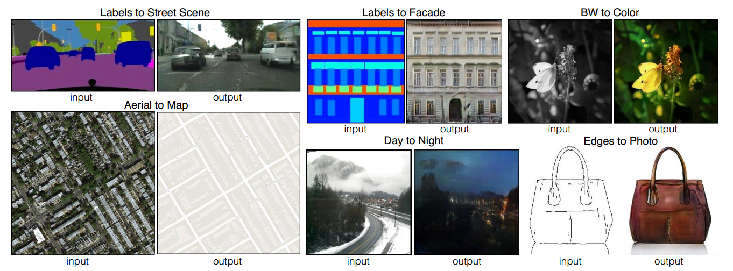
Tasks
Notes:
6/9 task

Slide 7
Solution
Traditional methods
each of these tasks has been tackled with separate, special-purpose machinery
Investigation on conditional adversarial networks
Not only learn the mapping, but also learn the loss function
A generic approach to different problems
Conclusion
We can achieve reasonable results without hand-engineering our loss function

Slide 8
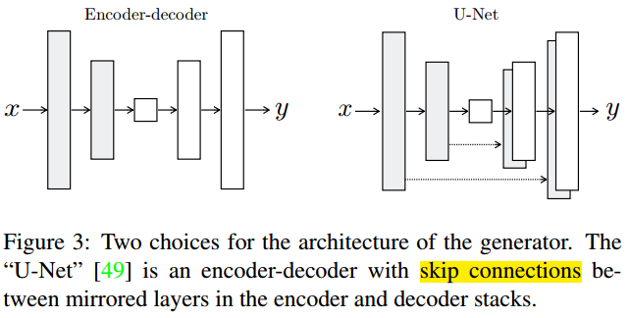
Model: Generator Network

Slide 9
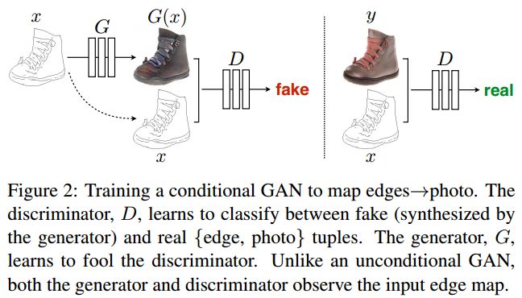
Model: Conditional GANs

Slide 10
Model: Patch discriminator
L2 and L1 Loss can capture low-frequency structure, although they produce blurring results
Need to model high-frequency structure
to restrict our attention to the structure in local image patches
We run the discriminator convolutationally across the image, averaging all responses to provide the ultimate output of D

Slide 11
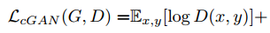
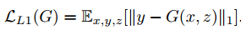
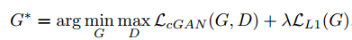
Pix2pix Loss
cGAN Loss:
L1 Loss:
Final objective:

Slide 12
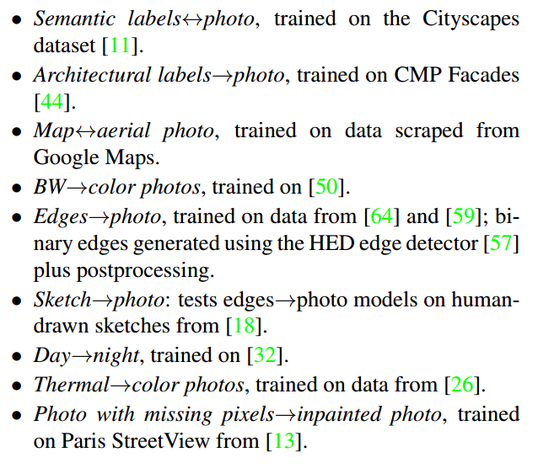
Experiments
Task and datasets
Metrics
Visualizing results
AMT
FCN scores

Slide 13
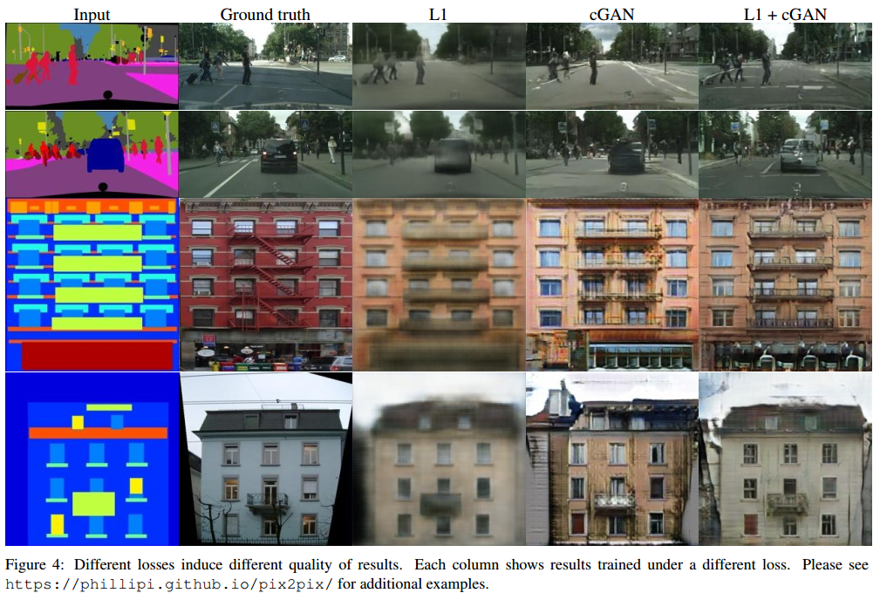
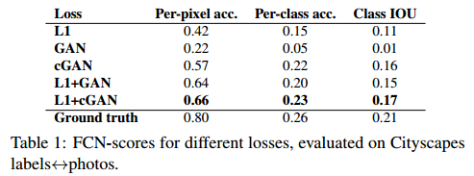
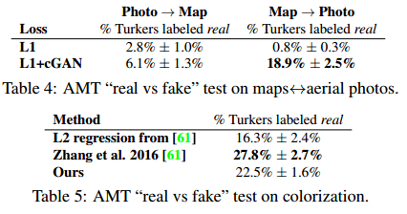
Experiments

Slide 14
SRGAN: Photo-Realistic Single Image Super-Resolution Using a GAN
CVPR 2017

Slide 15
Task
Recover the finer texture details when we super-resolve at large upscaling factors
First framework capable of inferring photo-realistic natural images for 4x upscaling factors.

Slide 16
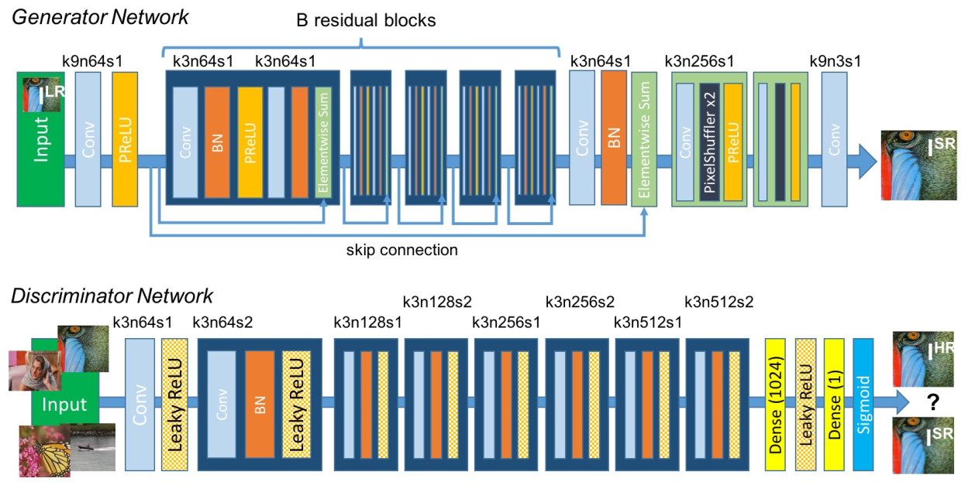
Model

Slide 17
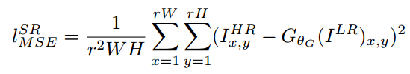
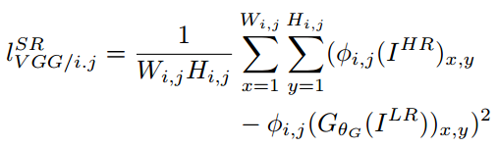
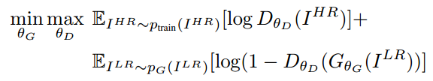
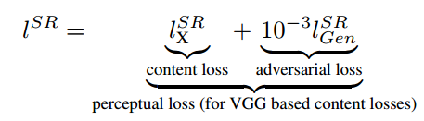
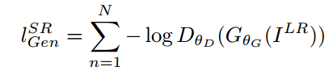
SRGAN Loss
Content loss:
Full Objective:
Adversarial loss:

Slide 18
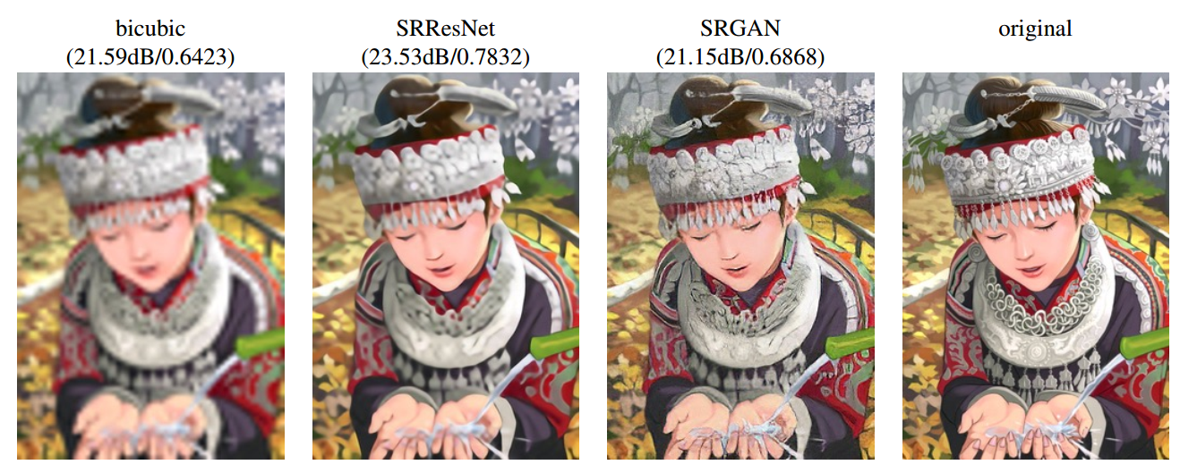
Experiments

Slide 19
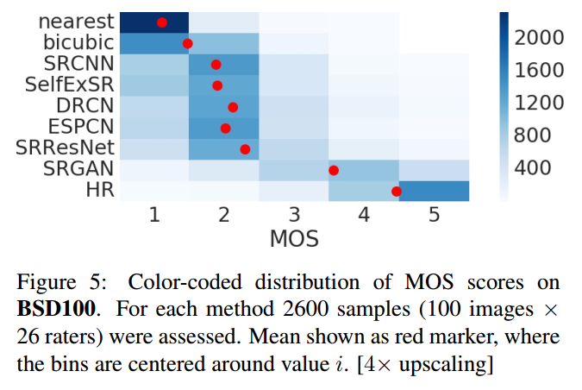
Experiments
DIAT: Deep Identity-aware Transfer of Facial Attributes

Slide 20
DIAT: Deep Identity-aware Transfer of Facial Attributes

Slide 21
Task
a unified solution for several representative facial attribute transfer tasks.
expression transfer
accessory removal
age progression
gender transfer

Slide 22
Model
A two-stage scheme is developed to tackle the identity-aware attribute transfer task.
Face transform network
Face enhancement network

Slide 23
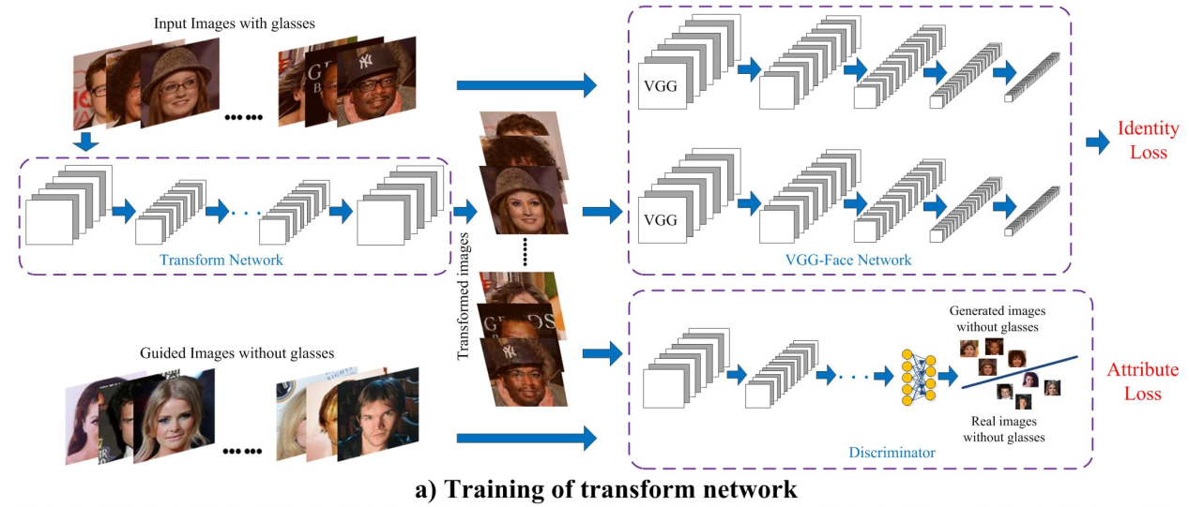
Model: Face transform Network

Slide 24
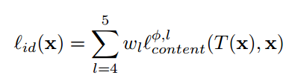
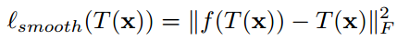
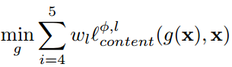
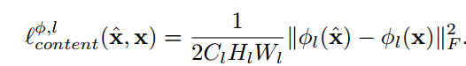
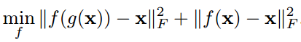
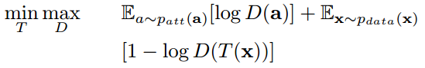
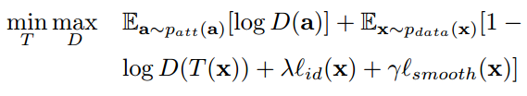
DIAT Transform Network Loss
Identity loss:
Perceptual regularization:
Attribute loss:
Final Loss:

Slide 25
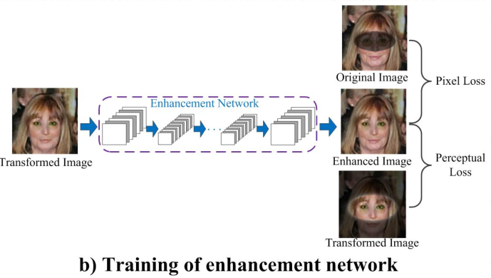
DIAT: Face enhancement network

Slide 26
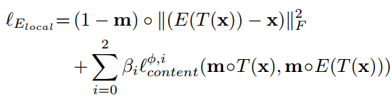
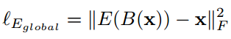
DIAT Enhancement Network Loss
Pixel loss
Perceptual loss

Slide 27
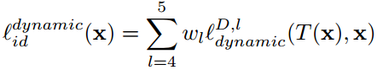
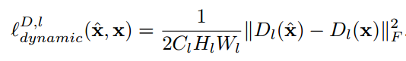
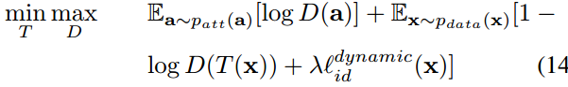
DIAT-A Transform Network Loss
In DIAT, the perceptual identity loss is defined on the pre-trained VGG-Face
Actually, it may be more effective to define this loss on some CNN trained to attribute transfer
Adaptive perceptual identity loss:
Final loss:

Slide 28
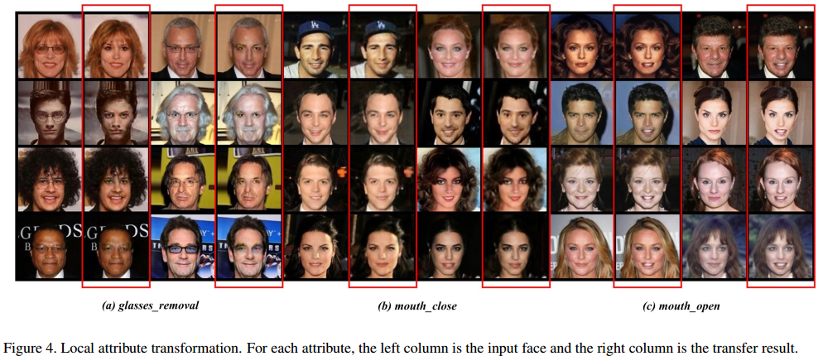
Experiments

Slide 29
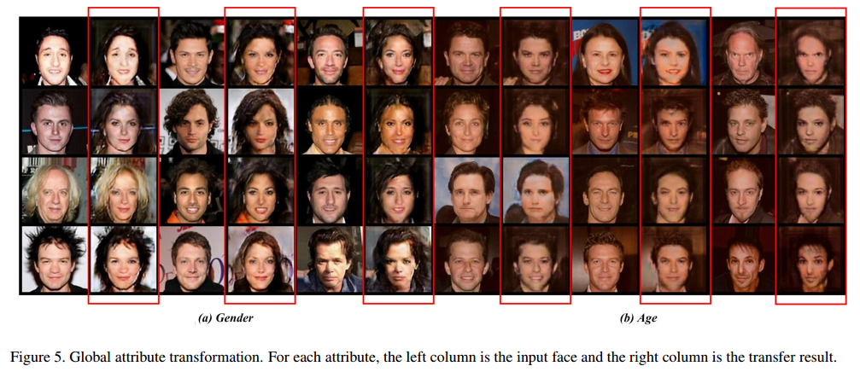
Experiments

Slide 30
CycleGAN: Unpaired Image-to-Image Translation using Cycle-Consistent Adversarial Networks
ICCV 2017

Slide 31
Introduction
Cross-domain image translation in the absence of any paired training examples
Solid experiments

Slide 32
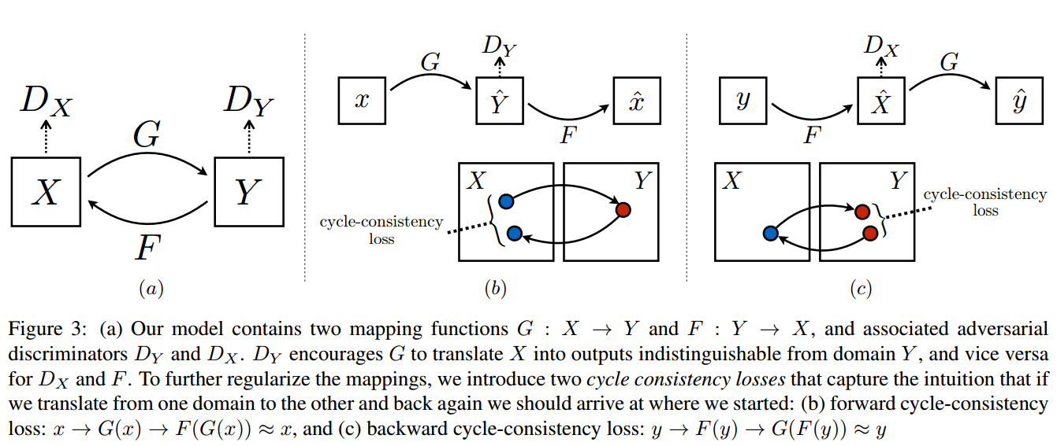
Model: cycle consistent

Slide 33
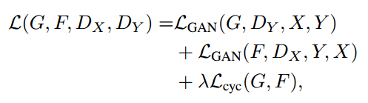
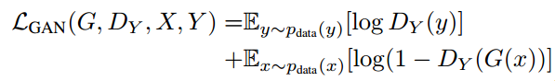
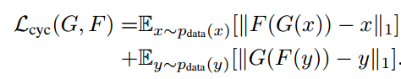
CycleGAN Loss

Slide 34
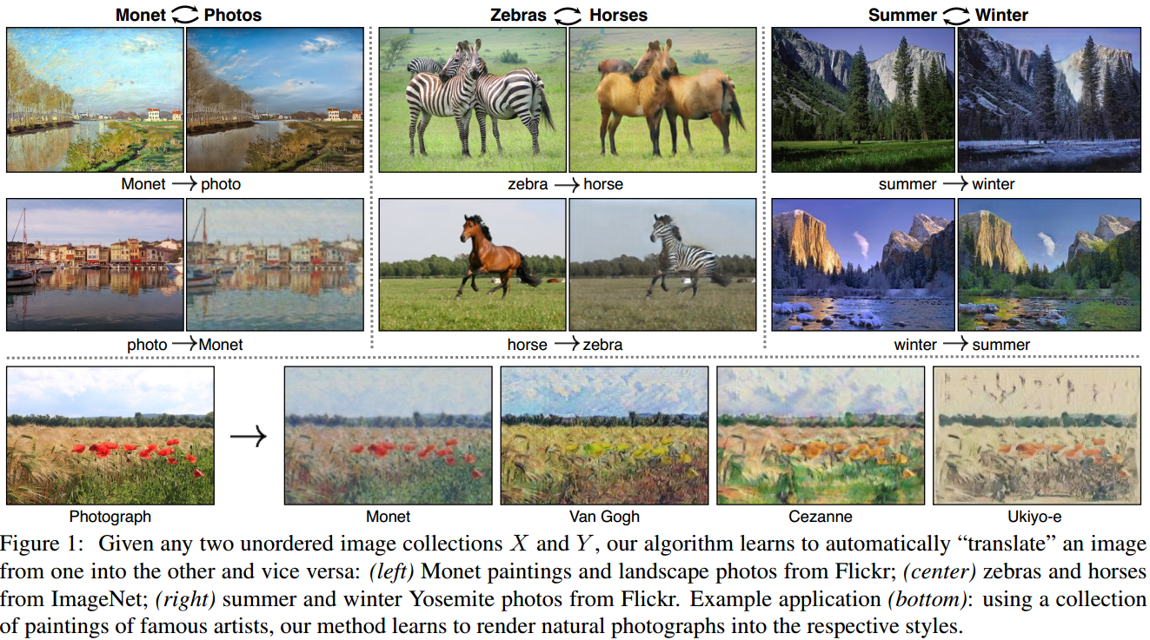
Experiments

Slide 35
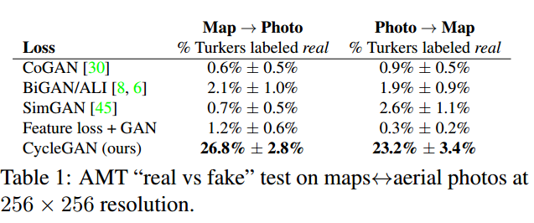
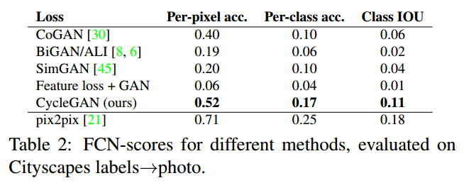
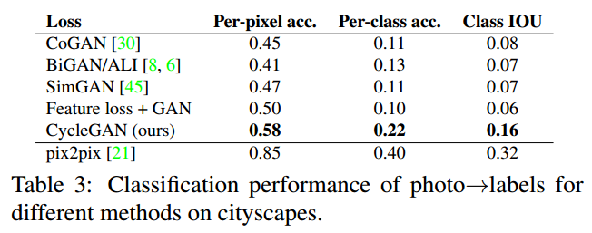
Experiments

Slide 36
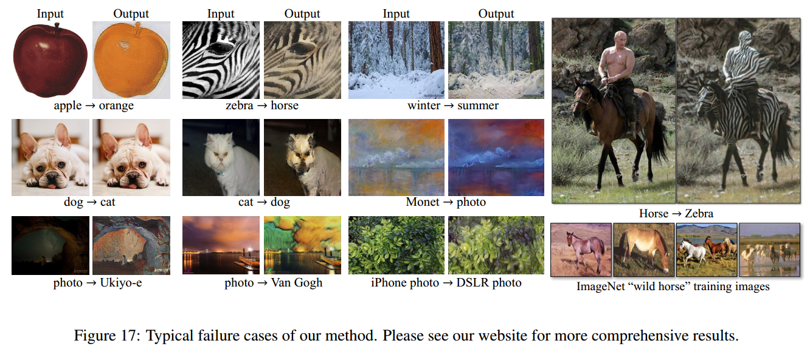
Experiments: limitations

Slide 37
Experiments

Slide 38
DTN: Unsupervised Cross-Domain Image Generation
ICLR 2017

Slide 39
Introduction
Recent Achievements
GAN, Style transfer, domain adaption methods, transfer learning
The capabilities do not address the general analogy problem synthesis
Specific task demo
MNIST number generation given the a street view house number
Emoij generation given a facial image

Slide 40
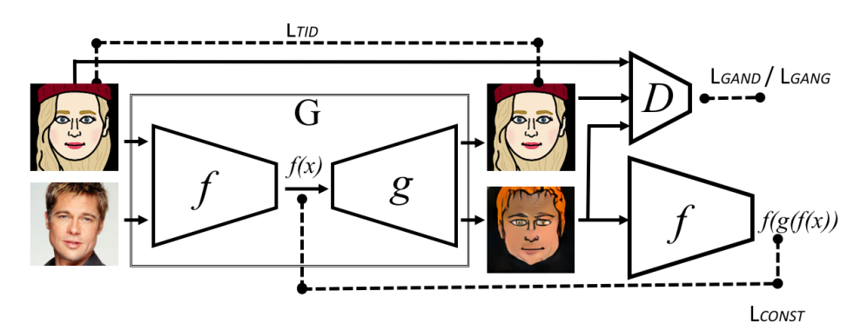
Model

Slide 41
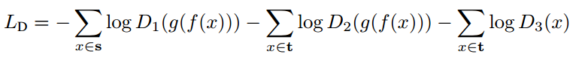
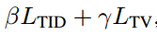




DTN Loss

Slide 42

Experiments

Slide 43

Experiments

Slide 44

Experiments

Slide 45
StarGAN: Unified GAN for Multi-Domain Image-to-Image Translation

Slide 46

Introduction
Existing approaches have limited scalability and robustness in handling more than two domains.
StarGAN: perform image-to-image translations for multiple domains using only a single model

Slide 47

Model

Slide 48







StarGAN Loss
Adversarial Loss:
Domain Classification Loss:
Reconstruction Loss:
Full Objective:

Slide 49



Training with multiple datasets
Mask Vector
Training Strategy
The same to training in one dataset except for using defined above as input to the generator

Slide 50



Experiments

Slide 51


Experiments

Slide 52

Conclusion
Good ideas:

Slide 53
Conclusion
Metrics
Human evaluation: AMT, MOS
Visualizing the generated results
Use a model in the target domain to evaluate: FCN Scores(MNIST classifiers, VGG face classifier)

